Slide 1
Walmart Superstore Analysis
Dashboards

Slide 2
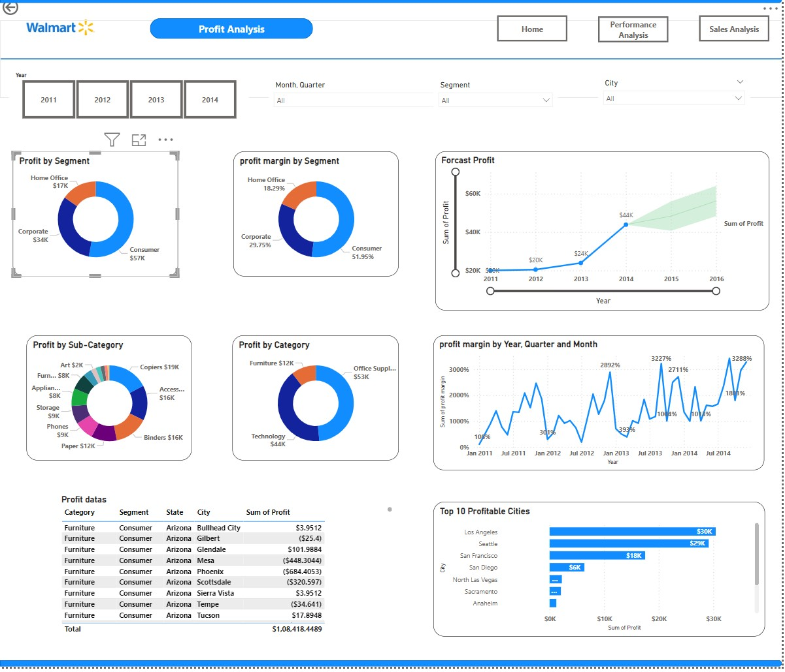
Profit Analysis
Profit Analysis
Profit Margin By Hierarchical dates
Forecast Profit predictions
Profit by Category
Profitable Customers By cities
Profit Datas

Slide 3
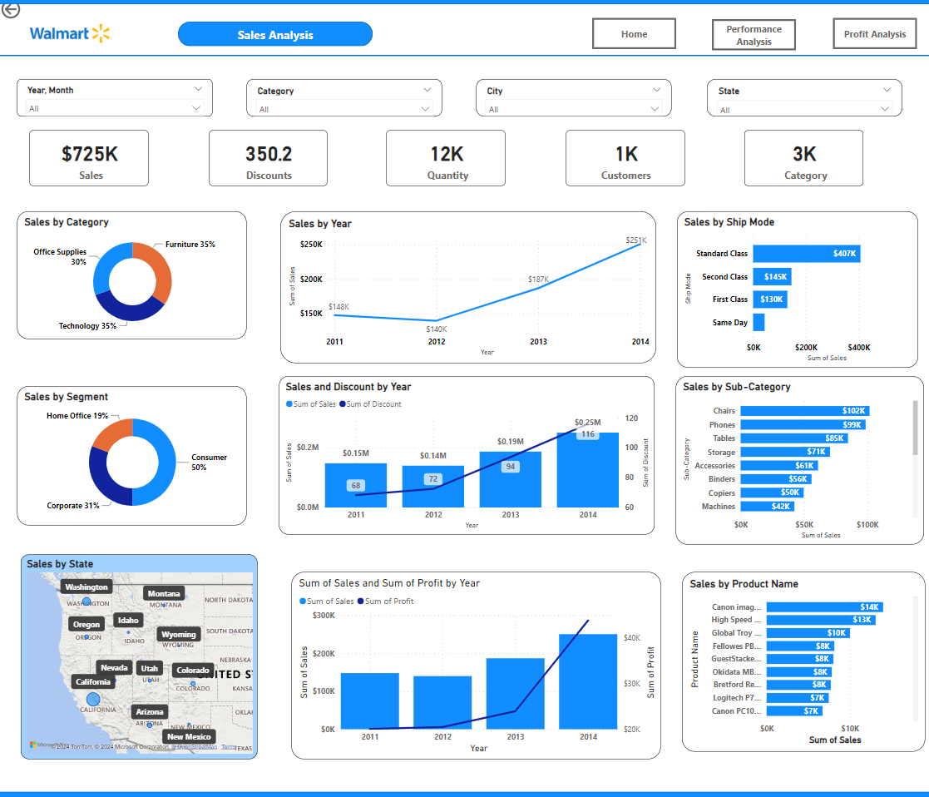
Sales Analysis
Sales Analysis
Sales & profit by year
Sales & Discounts
Kpi of Total sales ,Discounts
Sales By Shipmode,category

Slide 4
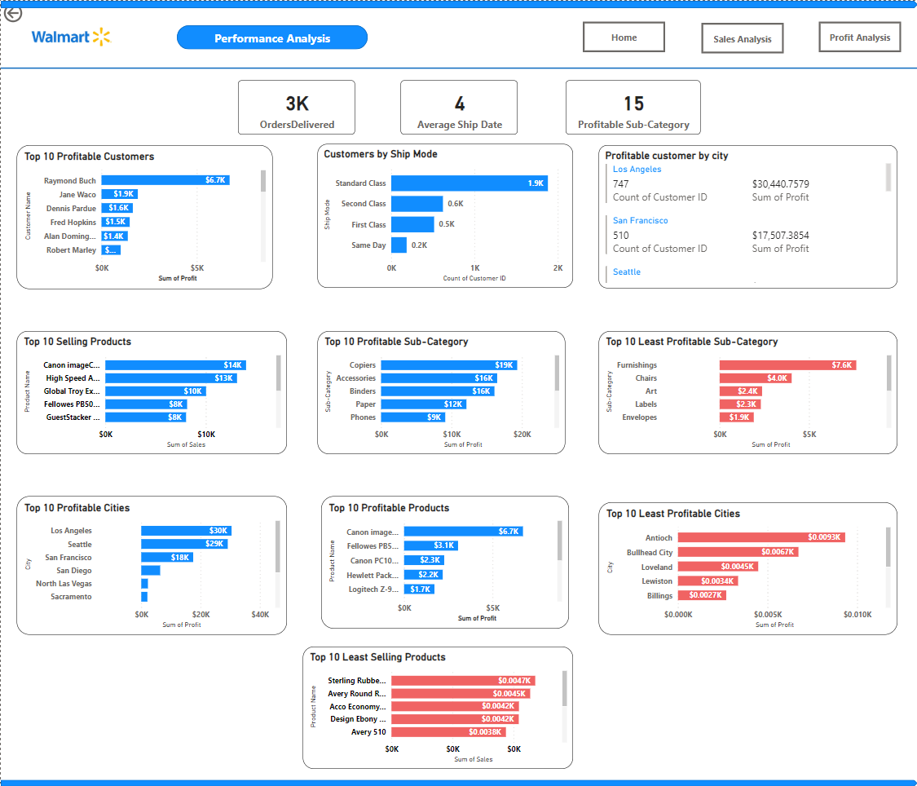
Performance Analysis
Customer Insight
Customers shipmode
Profitable Customers
Profitable Customers By cities
Performances & improvements
Top 10 selling products
Top 10 profitable products
Top 10 Least Selling products
Top 10 profitable cities

